Slide 1


Visualizations in Digital Humanities
Case study: Swemper Dataset Explorer
Workshop: Basic visualizations in Python with book metadata
Sushruth Badri
Centre for Digital Humanities and Social Sciences
Department of ALM
Uppsala University
Notes:
Hello everyone. I'm a research engineer. My background is in Data Science and my job is to build tools that help researchers answer their questions - research development like Matts mentioned earlier.
Today’s session is about visualization as an analytical method. I’ll begin with a dashboard case study, then move into very basic chart types, when to use them, and finally a short Python workshop.

Slide 2
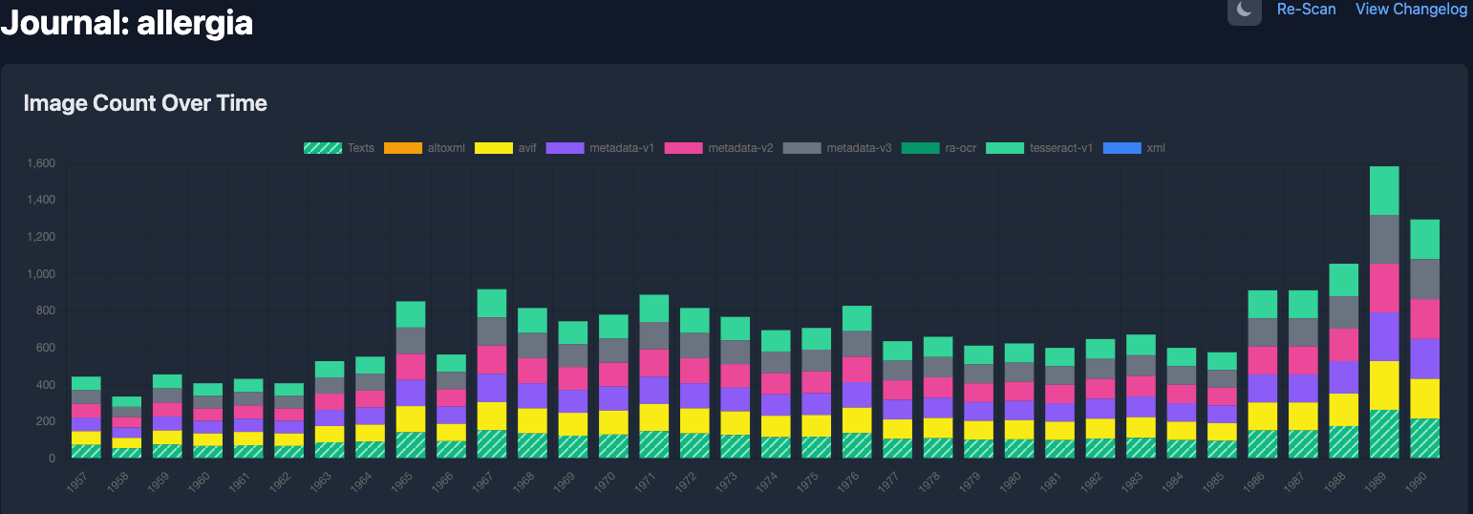
Why visualization matters in Digital Humanities
DH data is often:
Large
Heterogeneous
Incomplete
Historical
Metadata-heavy
Visualizations help us:
Compare
Explore
Detect patterns
Reveal gaps
Communicate findings
A stacked bar graph over time from the swemper dashboard
Notes:
In digital humanities, data is rarely perfectly clean. Visualization helps us not only summarize content, but also see the structure and limitations of the data itself.

Slide 3
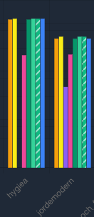

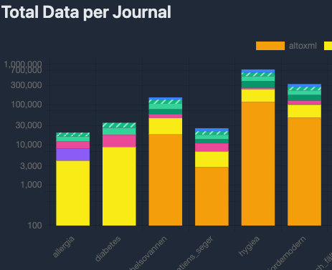
Start with the question, not the chart
Before choosing a chart, ask:
What do I want to know?
Am I comparing categories?
Am I looking at change over time?
Am I showing part-to-whole?
Do exact values matter?
Do I need raw values or normalized ones?
Stacked Bar graph
Ring chart
Bar graph
Notes:
The key idea is that chart choice should follow the analytical question. Different visual forms support different kinds of interpretation.

Slide 4
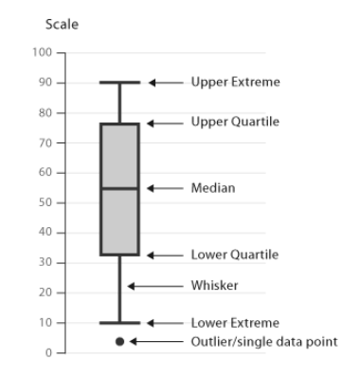
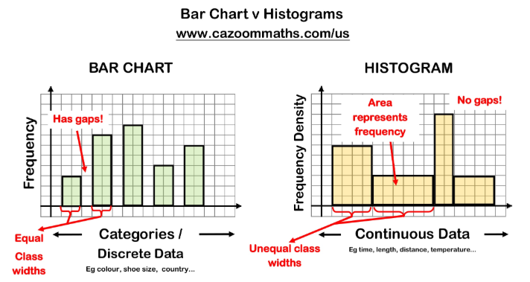
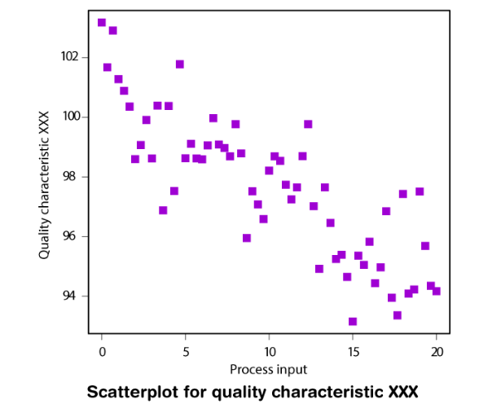
Match chart to analytical task
Question type | Useful visualization
Compare categories | Bar chart
Show part-to-whole | Pie chart, stacked bar, 100% stacked bar
Show change over time | Line chart, bar chart over time, timeline
Show distribution | Histogram, box plot
Show relationships | Scatter plot
Show exact values and metadata | Table
Box plot
Notes:
Histogram Continuous numerical data, Bar Chart Categorical data
This is one of the most useful heuristics in visualization design. Think in terms of tasks and outcomes.
Then you can play with colors for representation for certain class etc for example scatter plot

Slide 5
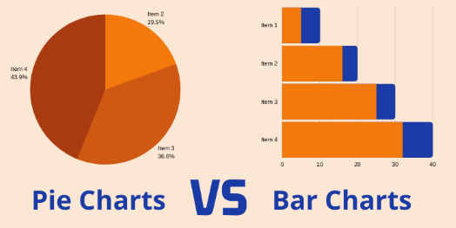
Compare
Bar charts | Pie charts
best for comparing categories | only useful for simple part-to-whole
support precise visual comparison | best with very few categories
work well with many categories | harder to compare precisely
Stacked bar chart | Grouped bar chart | 100% stacked bar chart
shows total + composition | better for comparing subcategories directly | best for comparing proportions
good for overview but harder to compare inner segments | can become cluttered if many subcategories | hides total size differences
Notes:
When in doubt, use a bar chart.
Humans compare lengths more accurately than angles. That is why bar charts are usually easier to read than pie charts.
This matters a lot in dashboards. Often one chart cannot do everything, so we use multiple linked views.
Use earlier slides to show bar visualisations

Slide 6
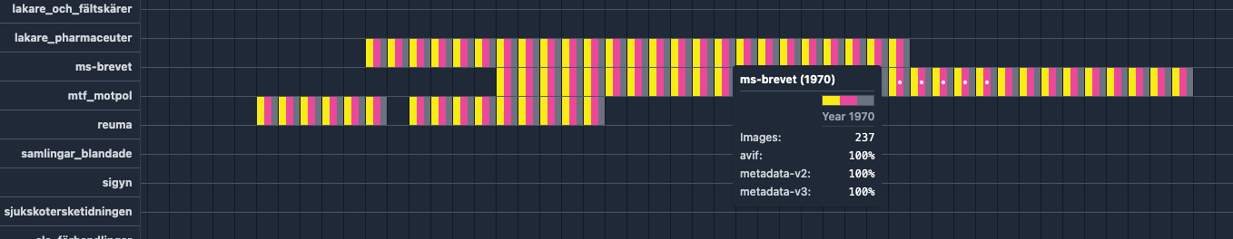
Compare
Use time-based charts when:
chronology matters
you want to see trends
you want to identify peaks, gaps, or periods of change
Common forms
Line chart
Bar chart over time
Event timeline
Timeline for journals in the swemper dataset
Notes:
In historical and cultural data, time often matters a great deal. The form depends on whether the data is continuous, event-based, or count-based.

Slide 7
Compare
Tables are useful when:
exact values matter
users need lookup
metadata status matters
detail is more important than visual pattern
Charts are useful when:
pattern matters more than exact numbers
Notes:
In dashboards, charts and tables should complement each other. The chart gives overview; the table gives precision.

Slide 8
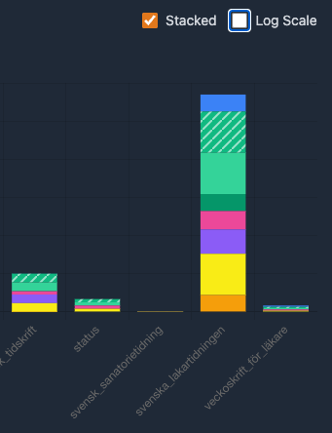
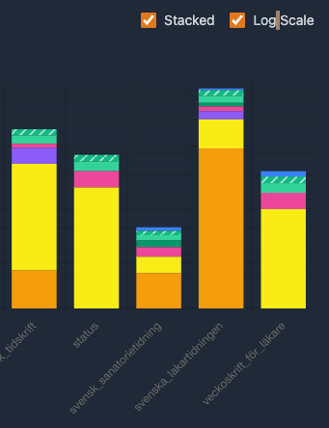
Scale and normalisation
Why scale:
Scale changes interpretation
Bar charts usually need a zero baseline
Log scales can help with very uneven values, but must be explained clearly
Normalisation matters too:
Normalization = making values comparable
Examples:
books per year
images per article
counts per 100 pages
Normalise when | Don’t normalise when
groups have very different sizes | total size is the actual question
you care about rates, not totals | the denominator is unclear
comparison should be fair across categories | normalization would hide important scale differences
Notes:
Scale is not neutral. It shapes what viewers think is large, small, stable, or dramatic.’
Raw values answer: how much? Normalized values answer: compared to what size?
If categories differ greatly in size, raw counts may mislead. Normalization helps us compare fairly.
Often the best choice is to show both absolute and normalized values.

Slide 9
Dashboard design principles
Overview first
Details on demand
Consistent colors
Readable labels
Purposeful interaction
Support both exploration and explanation
Swemper Dataset Explorer: overview
compares journals
shows total data volume
shows composition of categories
highlights completeness and missingness
Notes:
In dashboards, charts and tables should complement each other. The chart gives overview; the table gives precision.
A dashboard should support a workflow. Users should be able to move from overview to anomaly detection to inspection.
We now look at the swemper dashboard

Slide 10
Workshop!!!
Now: build a few visualizations in Python
We will use a small books metadata dataset to explore:
bar charts
pie charts
timelines
And more

Slide 11
Thank You

